Slide 1
News Portal
Presented by:
Sumit Gautam
Suvrat Ghimire
Badal Shrestha
Bikal Shrestha

Slide 2
Introduction
Online website to read news
Helps to access news articles anywhere and anytime by connecting to the internet

Slide 3
Objectives
Provides all type of news to the user and they could read anytime
To make NewsBox available on all the internet accessible devices

Slide 4
Tools and technology
Python
Django
Vs code

Slide 5
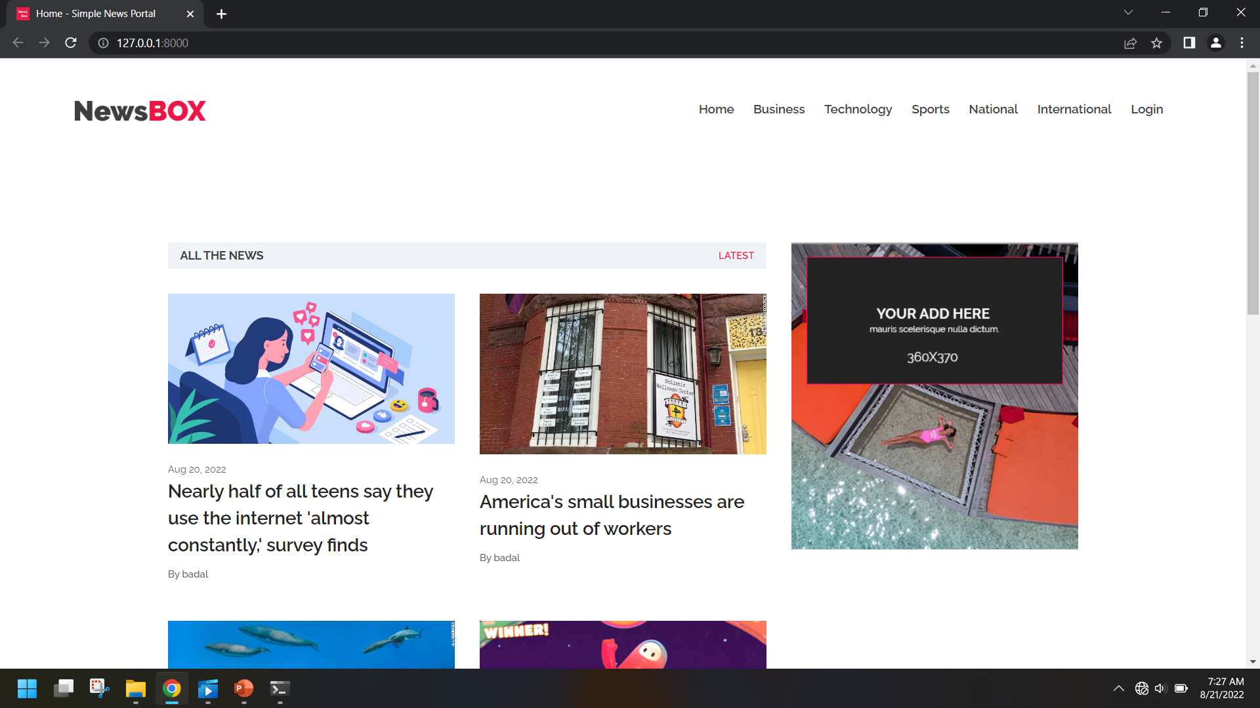
System Design

Slide 6
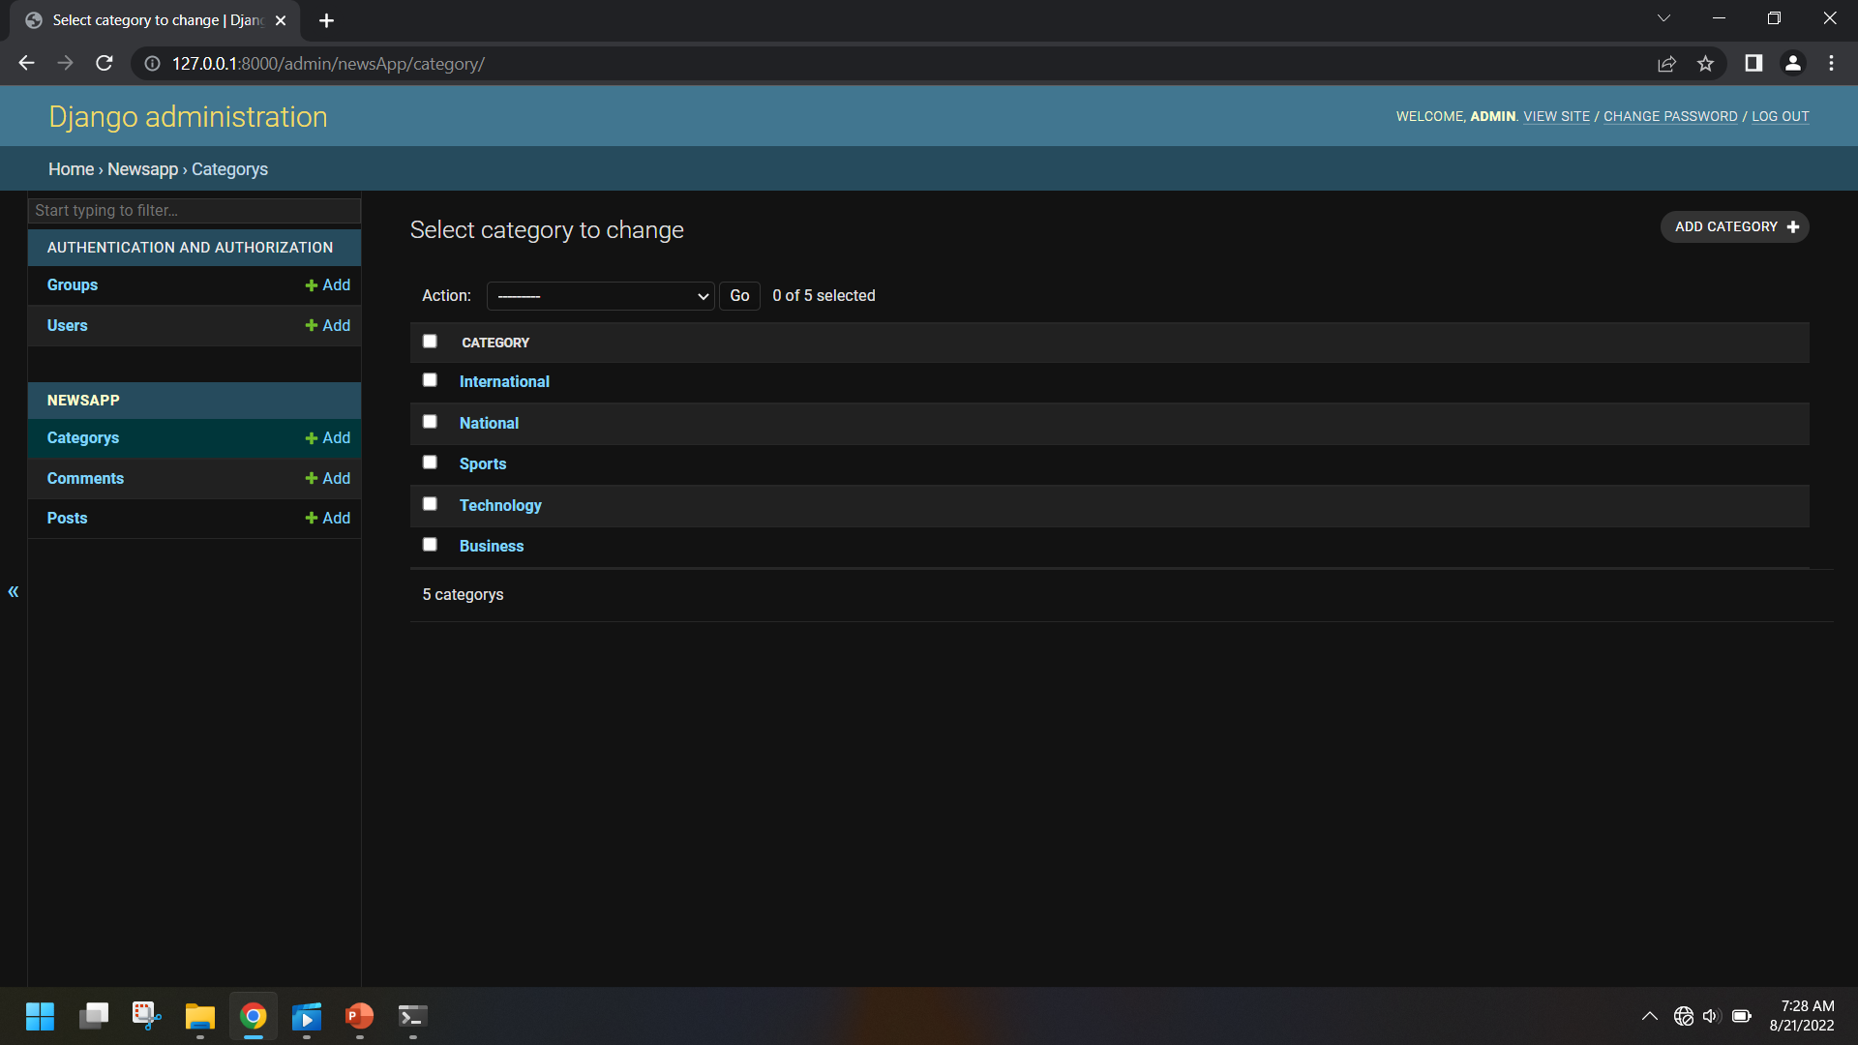
System Design (Admin)

Slide 7
System modules
Admin module
Reader module
Author module
Login module
Comment module

Slide 8
Dataflow diagram
Admin
Admin
Login
Add news
Edit news
Delete news
Manage Authors

Slide 9
Dataflow diagram
Author
Author
Login
Add news
Delete news
Edit news
Read News

Slide 10
Dataflow diagram
Reader
Reader
Read Articles
Comment/
Reviews

Slide 11
Scope & Limitation
Scope
Read news articles online
Readers can leave their comments and reviews
Instant fresh news all over the world
Limitations
Requires internet connection
Not accessible by people in remote areas

Slide 12
Future improvements
Discussion forum for readers
Mobile Application
Search engine recommendation

Slide 13
Conclusion
In this project we have learned how to start, setup, and bring online a news website.

Slide 14
Thank you!!!

